Slide 1
BC2406 Group Assignment:
Gender
Discrimination Lawsuit
Analytics Consultant for the Female Doctors
Chou Chan Sovita | Jessica Teng Jia Jia | Lau Yee Hey | Murugappan Sivabalan | Su Nanda Moe | Teo Yu Xiang Ryan

Slide 2
Thesis Statement
Analytics Consultant for Female Doctors
Fighting for female plaintiff’s cause
Hence, proving our claim by showing data suggesting discrimination against female doctors, compared to male counterparts
Notes:
For our lawyer case, we are fighting for the female plaintiff’s cause. Hence, we will be proving our claim by showing both categorical and continuous data suggesting discrimination against female doctors, compared to male counterparts.

Slide 3
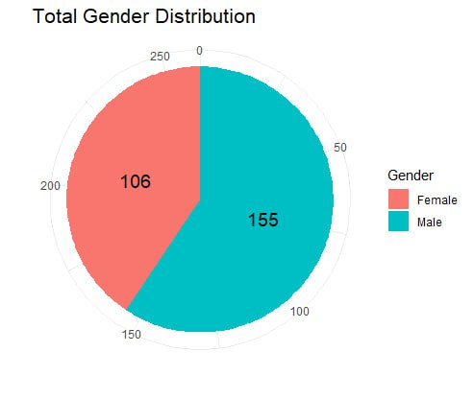
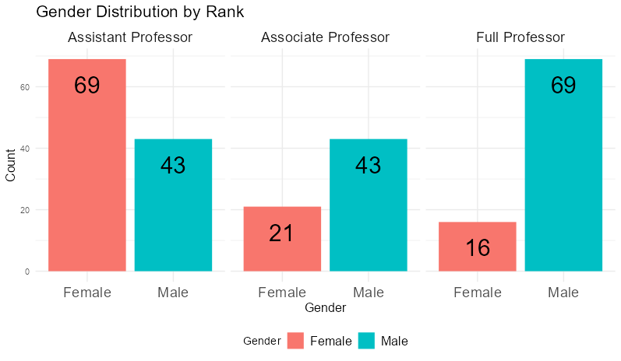
Data Exploration: Gender Distribution
Yee Hey
Gender distribution skewed towards males, which is of higher proportion than females
Uneven gender distribution across ranks
higher proportion of females in
the Assistant Professor rank
higher proportion of males in
the Full Professor rank
Notes:
The graph on the left shows the total gender distribution.
Overall: There is a slight imbalance in gender distribution, with a higher proportion of males.
Female: There are 106 females.
Male: There are 155 males.
In summary: The gender distribution is skewed towards males, with a ratio of approximately 1.5 males to 1 female.
The graph on the right shows the gender distribution among three faculty ranks: Assistant Professor, Associate Professor, and Full Professor.
Overall: There is a slight imbalance in gender distribution across the ranks, with a higher proportion of females in the Assistant Professor rank and a higher proportion of males in the Full Professor rank.
Assistant Professor: The highest number of individuals are in this rank, with a relatively equal distribution between females and males.
Associate Professor: The number of individuals in this rank is slightly lower than Assistant Professor. There is a slight imbalance towards males.
Full Professor: The number of individuals in this rank is the lowest among the three. There is a significant imbalance towards males.
In summary: While the gender distribution among Assistant Professors is relatively balanced, there is a clear trend towards a higher proportion of males as individuals progress through the faculty ranks.

Slide 4
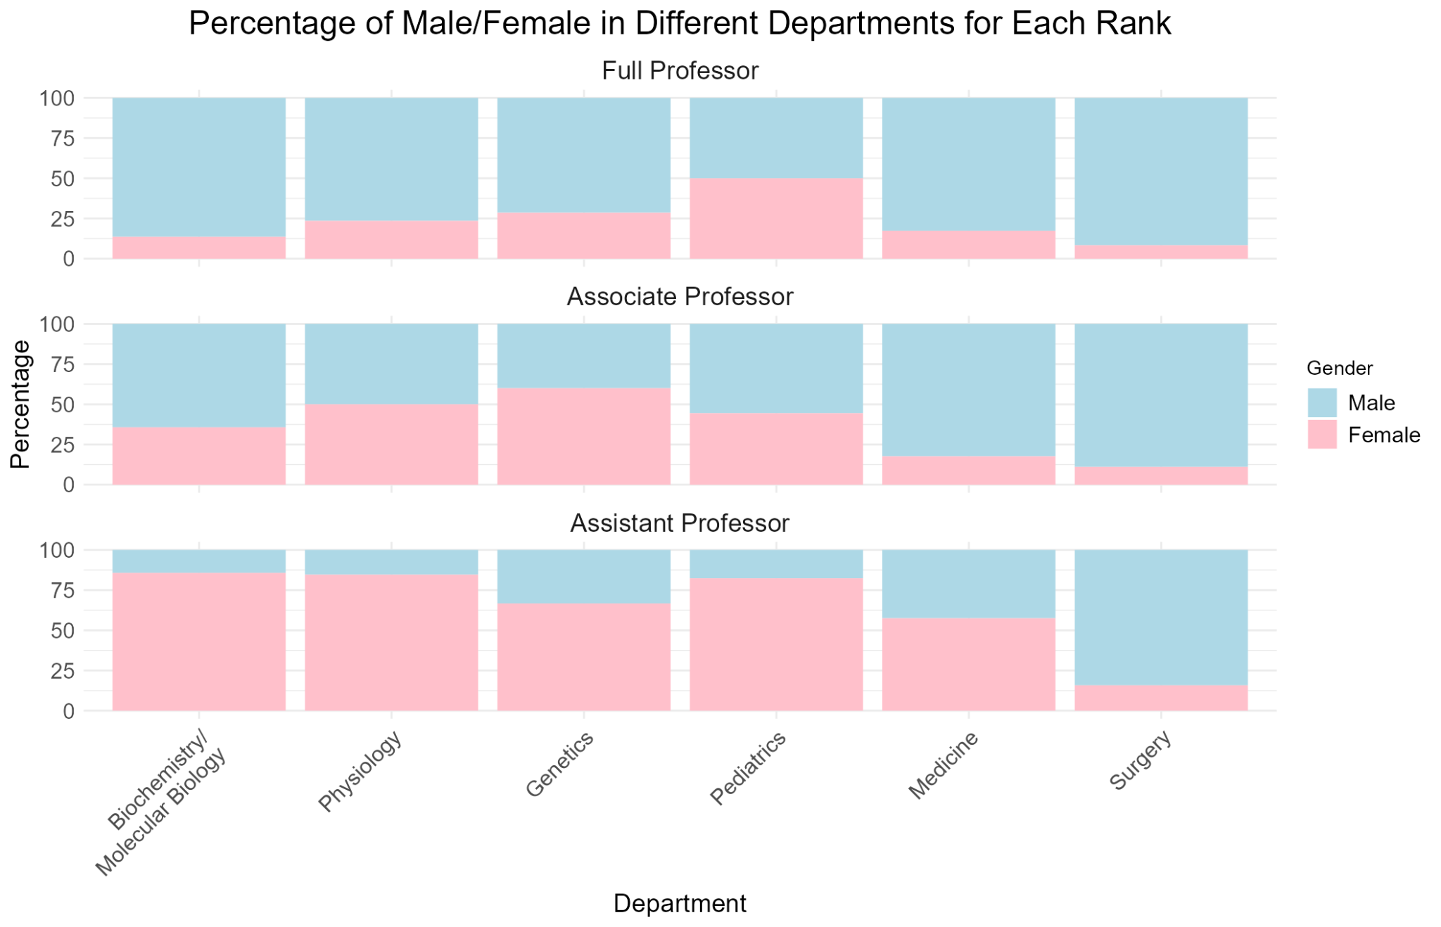
Percentage Distribution of Genders Across Ranks (Arranged by Department)
Su
This stacked bar graph illustrates the distribution of genders within various departments across different ranks.
Gender distribution across ranks
Full Professors
Higher proportion of Males compared to Females across all departments
Associate Professors
Somewhat balanced gender distribution
Assistant Professors
Higher proportion of Females across most departments
Conclusion
Disparity in gender representation
Males predominantly distributed at Full Professor level
Females concentrated at Assistant Professor level
Notes:
Make the font sizes in the diagram bigger

Slide 5
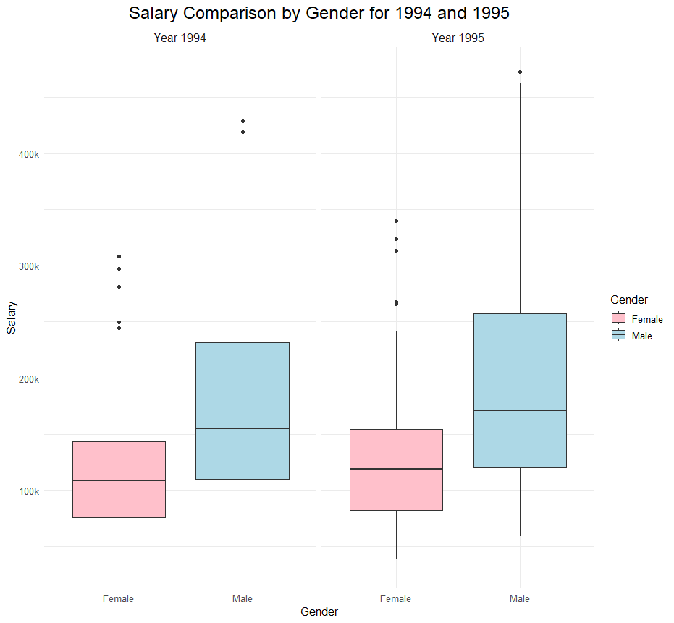
T-Test on Differences in Mean Salaries
Welch’s T-Test:
Variances/Sample Sizes are different
Year 1994
Year 1995
Ryan Teo
As a whole population, is it true to say that the females have on average a lower salary than the males?
Null Hypothesis: The female mean salary is equal to the male mean salary (for both years)
data: female_sal94 and male_sal94
t = -6.6457, df = 258.53,
p-value = 1.778×10⁻¹⁰ (<<0.05)
Reject Null Hypothesis:
True difference in means is not equal to 0
Mean(Female Pay) vs Mean(Male Pay)
118871.3 vs 177338.8
data: female_sal95 and male_sal95
t = -6.5905, df = 258.53,
p-value = 2.446×10⁻¹⁰ (<<0.05)
Reject Null Hypothesis:
True difference in means is not equal to 0
Mean(Female Pay) vs Mean(Male Pay)
130876.9 vs 194914.1
Females earn 33.0% less than Males ON AVERAGE in 1994
Females earn 32.9% less than Males ON AVERAGE in 1995
Reasonable to conclude that there exists discrimination of salaries between Genders

Slide 6
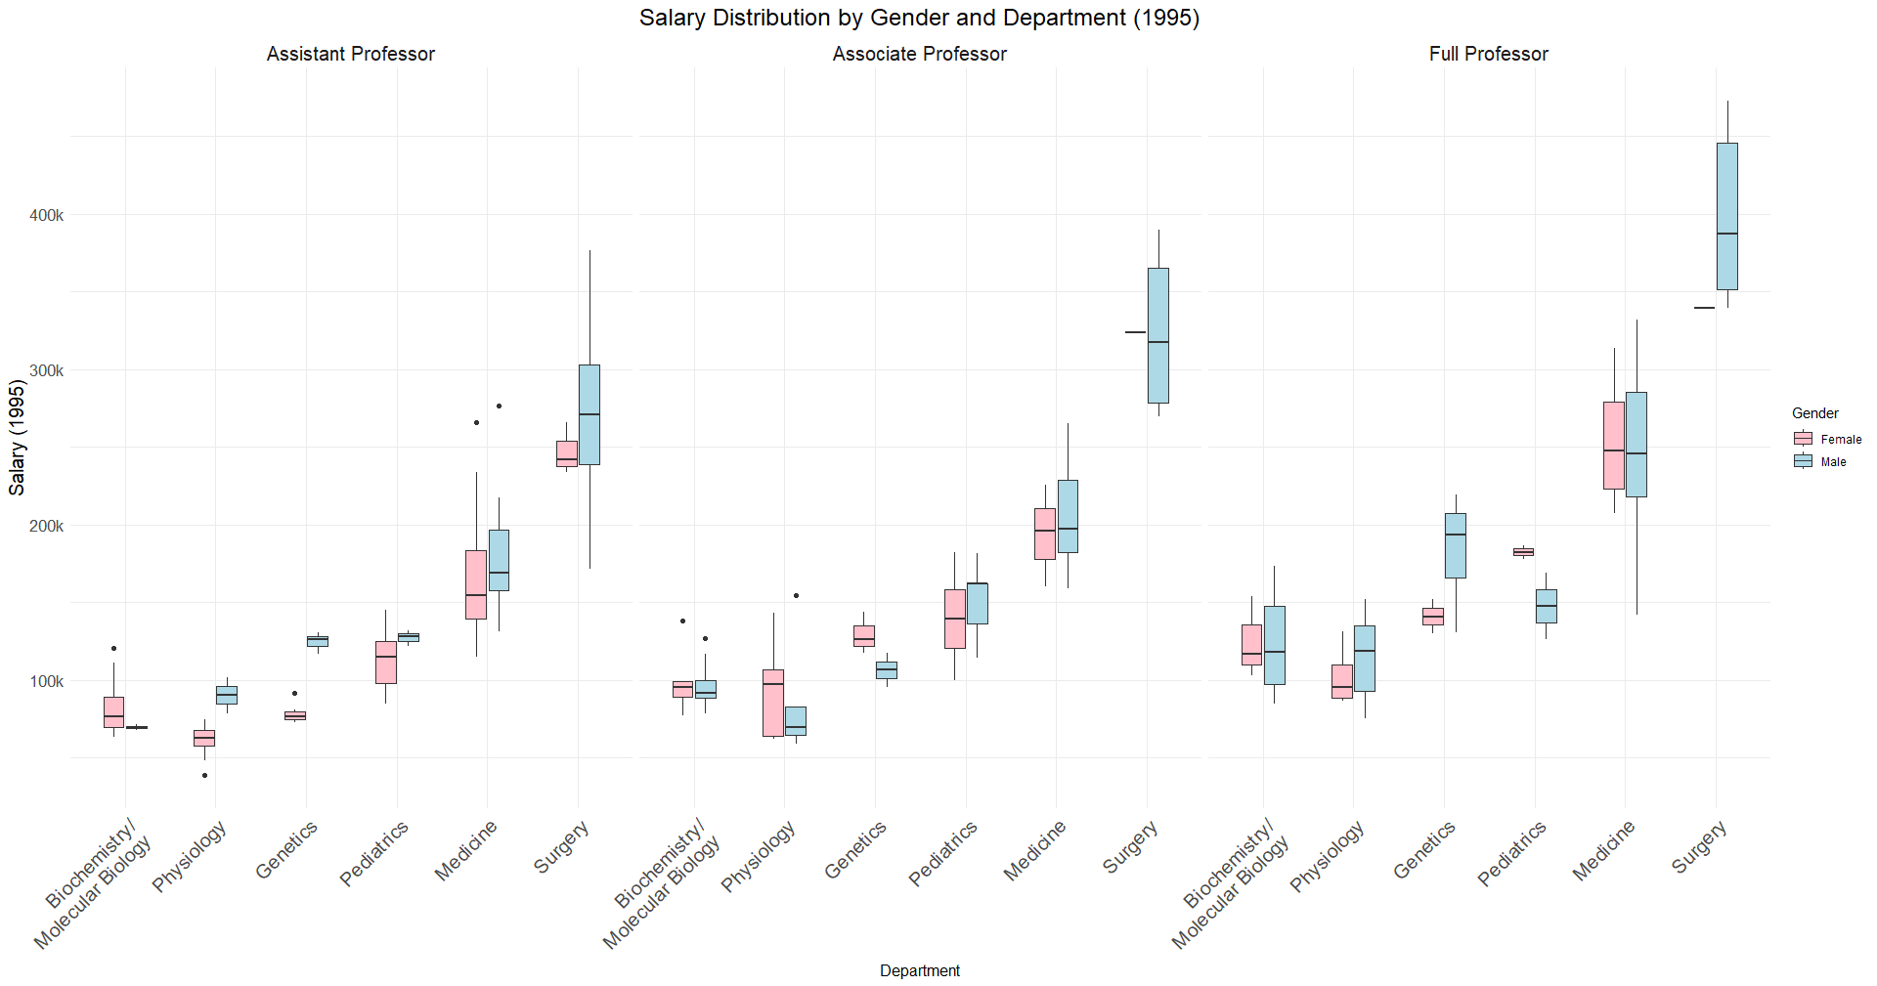
Salary Distribution
Ryan Teo
Circles in Red highlights the females (sorted by department and rank) that are susceptible to salary discrimination
While there exists discrimination in some departments, we recognize that other departments may not share the same sentiments (highlighted in Blue)

Slide 7
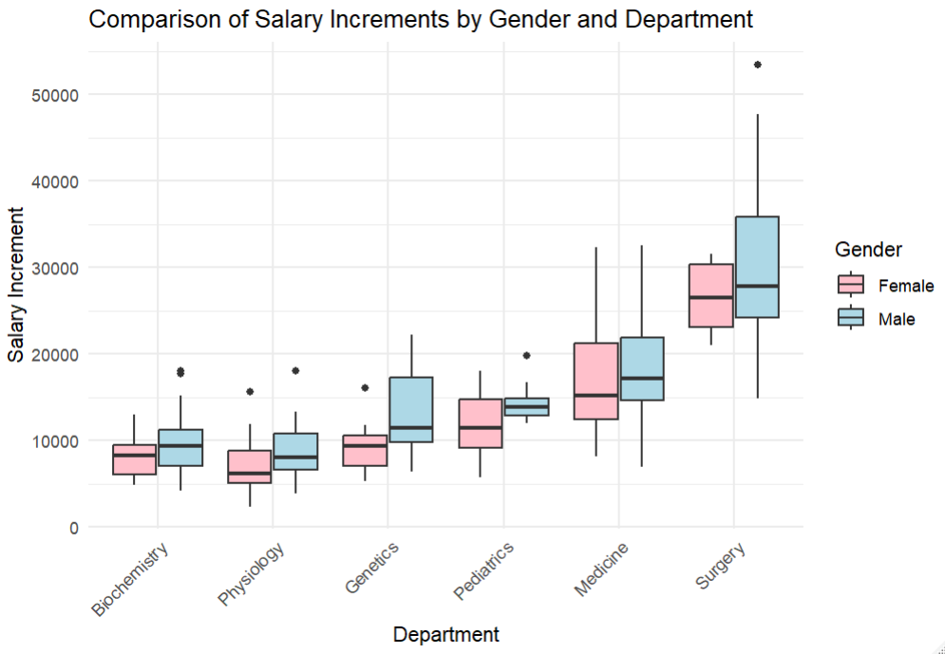
Salary Increment Comparison
Sovita
The boxplots show the comparison between the salary increment of men and women in 1994 in 1995, within each department.
Overall trend: In general, the box plot shows that men mostly receive a higher salary increment in comparison to women in all the different departments. This supports our argument that there is discrimination against women, as their salary is increasing at a slower rate than men within the same department.

Slide 8
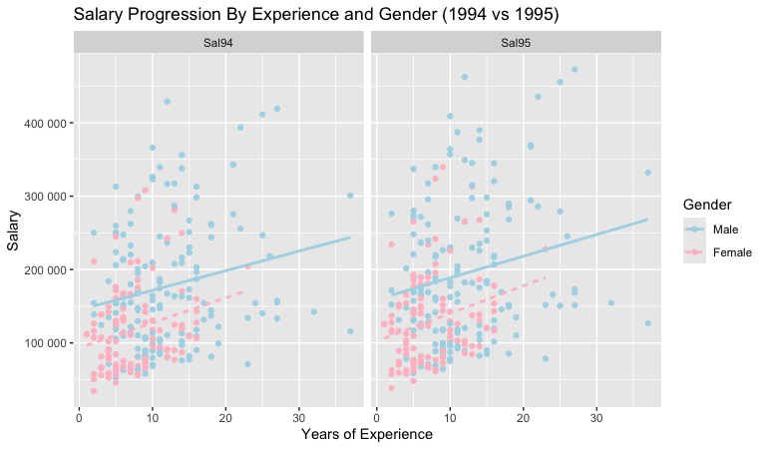
Salary Progression By Experience & Gender
Jessica
This is Salary Progression based on Gender and Experience for Year 1994 and 1995.
We can see from the red box at 10 Years of Experience the pink dots (females) are more clustered towards lower salary end between 100,000 and 200,000. The blue dots (males) whereas are clustered around the higher salary end between 200,000 to 300,000.
There is discrimination of salaries between genders despite same years of experience

Slide 9
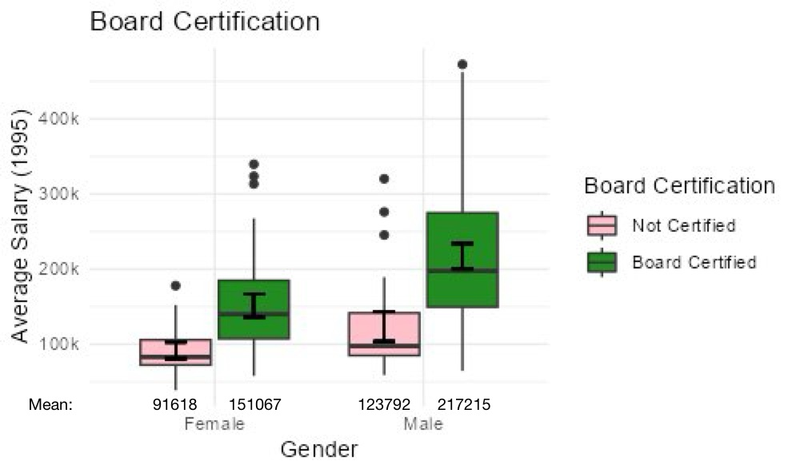
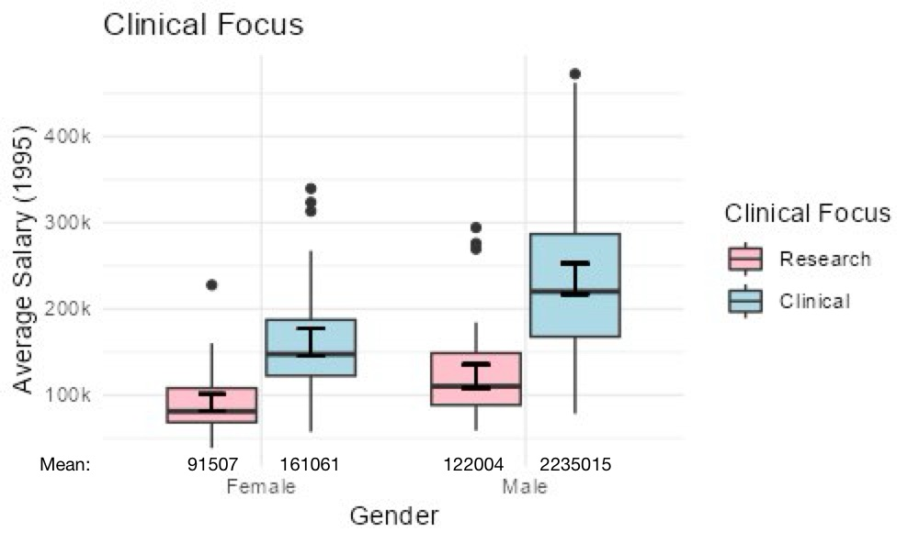
Gender vs Salary by Board Certification and Clinical Focus
Yee Hey
Mean and median salary (1995) for males higher than females’,
regardless of board certification and clinical focus
Males experience greater salary increment than females, when they become board certified or switch "Research" to "Clinical"
Gender discrimination in salary → lower pay for females
Notes:
GENERAL: While board certification is associated with higher salaries for both genders, median salary for males higher than for females, regardless of board certification status.
Impact of Board Certification on salary: males experience a larger increase in salary when they become board certified compared to females. → Gaining certified is more rewarded for males than for females
GENERAL: While those in “Clinical” have higher salaries than those in “Research", median salary for males is higher than for females, regardless of clinical focus.
Impact of clinical focus on salary: males experience larger increase in salary when they switch from "Research" to "Clinical" compared to females. → "Clinical" focus is more rewarded for males than for females
Gender discrimination in salary → lower pay for females, even when considering board certification and clinical focus
—--------------------
GENERAL: median salary for males is higher than for females, regardless of board certification status.
Board Certification: For both genders, board certification is associated with higher salaries compared to not being certified.
Impact of Board Certification on salary: males experience a larger increase in salary when they become board certified compared to females. → Gaining certified is more rewarded for males than for females
GENERAL: median salary for males is higher than for females, regardless of clinical focus.
Clinical Focus: For both genders, individuals in the "Research" focus tend to have higher salaries compared to those in the "Clinical" focus.
Impact of clinical focus on salary: males experience a larger increase in salary when they switch from "Research" to "Clinical" compared to females. → "Clinical" focus is more rewarded for males than for females

Slide 10
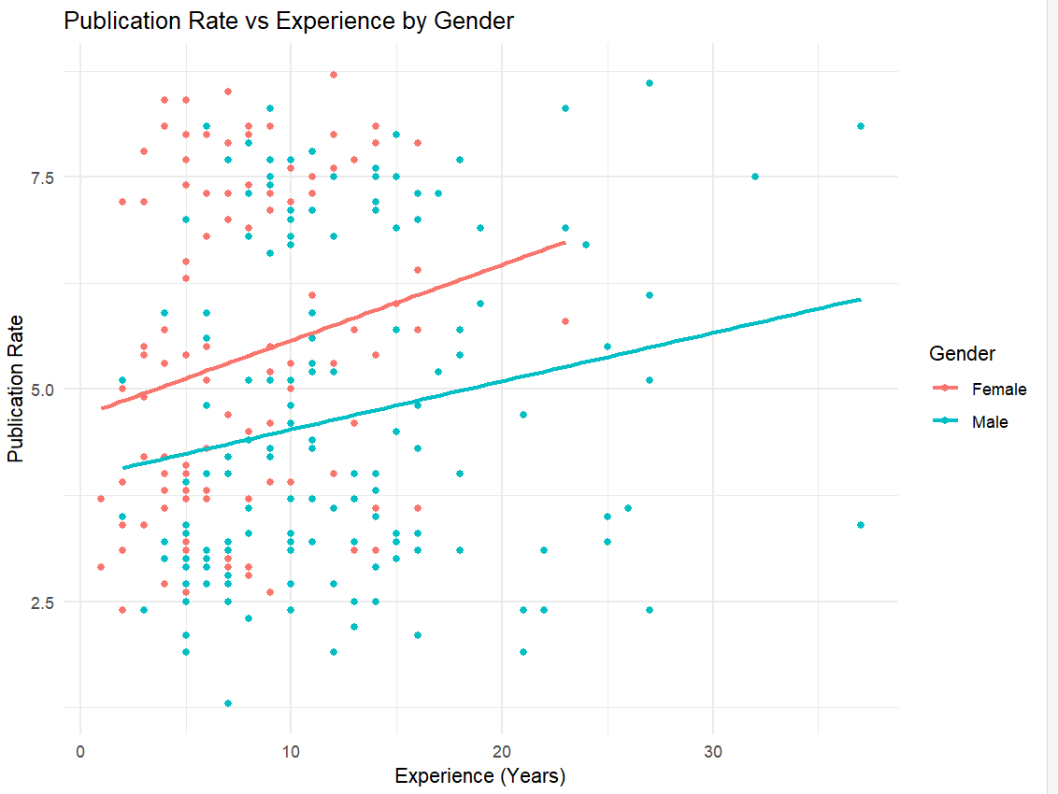
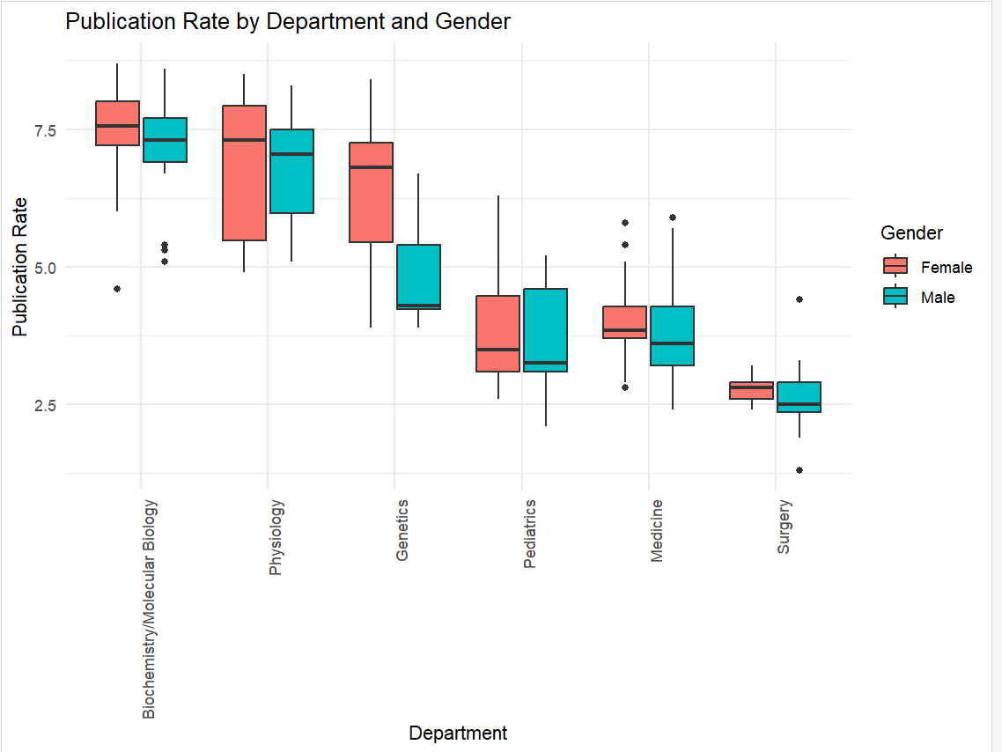
Publication Rate by Gender and (Exp, Dept)
Muru
Female doctors show higher publication rates than males, especially in early to mid-career stages.
Despite higher productivity, female doctors face slower career progression and potential salary gaps.
In research departments like Biochemistry and Physiology, females outperform males in publication rates, yet still encounter barriers to recognition and advancement.
Clear evidence of gender discrimination in academic productivity vs. career outcomes.

Slide 11
Conclusion
Gender Distribution
Salary
Disparities
Publication Performance
Yee Hey
Females underrepresented at higher faculty ranks, while males are overrepresented
Females earn less than males on average
Females experience lower salary growth than males
Females outperform males, but career recognition is not reciprocated
There is systemic gender discrimination in salary and career advancement against females, despite comparable qualifications, experience, and performance as males.
Notes:
Salary Disparity:
Overall: Females consistently earn less than males on average, even when controlling for board certification and clinical focus.
Salary Progression: Females experience slower salary growth compared to males, particularly after 24 years of experience.
Board Certification: While board certification is associated with higher salaries for both genders, the increase is more pronounced for males.
Clinical Focus: Similarly, the shift from "Research" to "Clinical" is more rewarding for males in terms of salary.
Publication Performance:
Research-Focused Departments: Females outperform males in terms of publication rates in departments like Biochemistry, Physiology, and Genetics.
Statistical Significance: In Genetics, females have a significantly higher publication rate (p = 0.00474), providing strong evidence of superior performance.
Gender Distribution:
Faculty Ranks: Females are underrepresented at higher faculty ranks (Associate Professor and Full Professor), while males are overrepresented.
Departmental Distribution: Females are concentrated in certain departments (Assistant Professor level), while males are more evenly distributed across ranks.
Conclusion:
The combination of these findings strongly suggests that there is a systemic gender-based bias in salary determination within the medical profession. Despite comparable qualifications, experience, and performance, female doctors are systematically disadvantaged in terms of salary and career advancement. This discrimination is evident in various aspects of their careers, including board certification, clinical focus, and faculty rank.
There is systemic gender discrimination in salary and career advancement within the medical profession against females, despite comparable qualifications, experience, and performance as their male counterparts.

Slide 12
Appendix

Slide 13
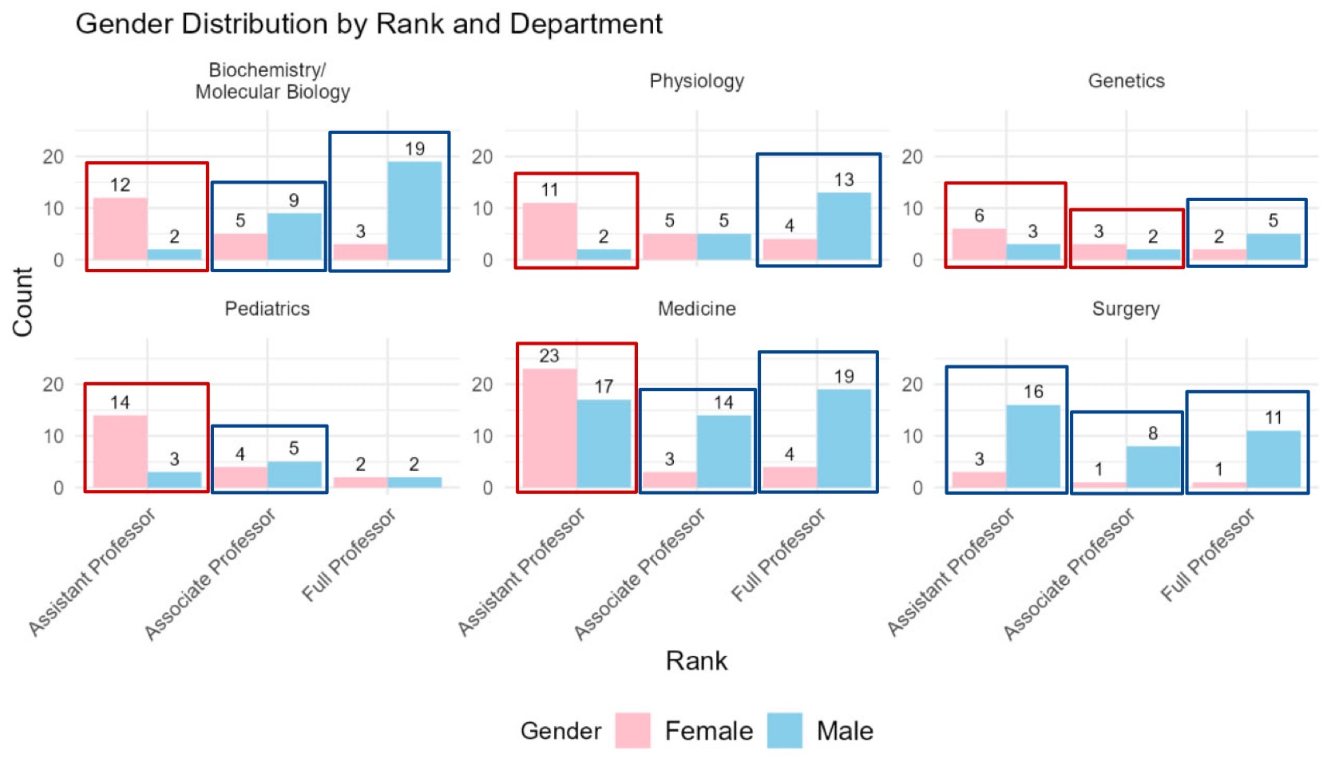
Data Exploration: Gender Distribution
Yee Hey
Uneven gender distribution across ranks and departments, with a higher proportion of males, especially in higher ranks.
As individuals progress through the ranks (from Assistant Professor to Full Professor), the proportion of males generally increases, while the proportion of females decreases.
Boxed in Red: Number of females more than males
Boxed in Blue: Number of males more than females
Notes:
Gender Imbalance: There is a general imbalance in gender distribution across ranks and departments, with a higher proportion of males, especially in higher ranks.
Higher Ranks: As individuals progress through the ranks (from Assistant Professor to Full Professor), the proportion of males generally increases, while the proportion of females decreases.
The gender distribution across ranks and departments is not uniform. There is a clear trend towards a higher proportion of males, especially in higher-level positions. While some departments exhibit a more balanced representation, the overall pattern suggests a systemic gender imbalance in the academic field.

Slide 14
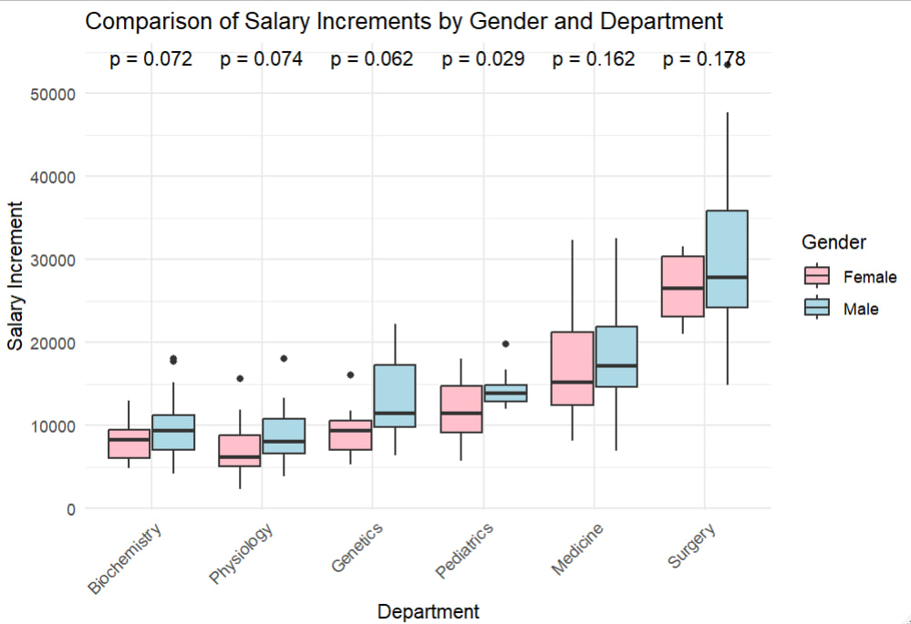
Salary Increment Comparison
Sovita
If p-value < 0.05, the difference is statistically significant.
If p-value ≥ 0.05, the difference is not statistically significant
The test results show that in the Pediatrics department the p-value = 0.029, which shows that the difference between salary increments between males and females is statistically significant. It supports that men are more favourably rewarded than women in terms of salary increases.

Slide 15
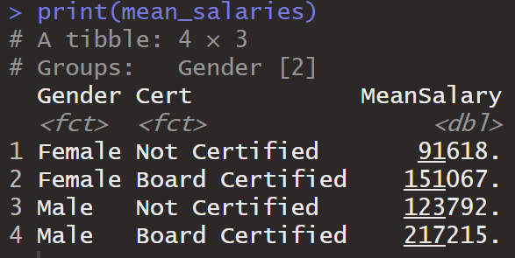
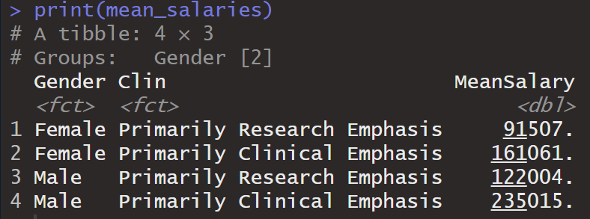
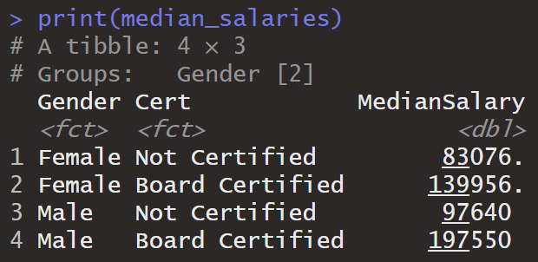
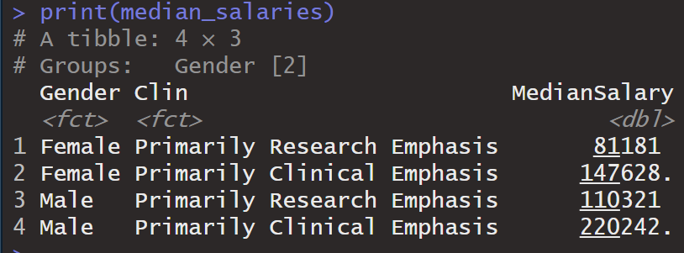
Gender vs Salary by Board Certification and Clinical Focus
Board Certification
Clinical Focus
Yee Hey
Mean and median salary (1995) for males higher than females’, regardless of board certification and clinical focus → Gender discrimination in salary
Notes:
GENERAL: While board certification is associated with higher salaries for both genders, median salary for males higher than for females, regardless of board certification status.
Impact of Board Certification on salary: males experience a larger increase in salary when they become board certified compared to females. → Gaining certified is more rewarded for males than for females
GENERAL: While those in “Clinical” have higher salaries than those in “Research", median salary for males is higher than for females, regardless of clinical focus.
Impact of clinical focus on salary: males experience larger increase in salary when they switch from "Research" to "Clinical" compared to females. → "Clinical" focus is more rewarded for males than for females
Gender discrimination in salary → lower pay for females, even when considering board certification and clinical focus
—--------------------
GENERAL: median salary for males is higher than for females, regardless of board certification status.
Board Certification: For both genders, board certification is associated with higher salaries compared to not being certified.
Impact of Board Certification on salary: males experience a larger increase in salary when they become board certified compared to females. → Gaining certified is more rewarded for males than for females
GENERAL: median salary for males is higher than for females, regardless of clinical focus.
Clinical Focus: For both genders, individuals in the "Research" focus tend to have higher salaries compared to those in the "Clinical" focus.
Impact of clinical focus on salary: males experience a larger increase in salary when they switch from "Research" to "Clinical" compared to females. → "Clinical" focus is more rewarded for males than for females

Slide 16
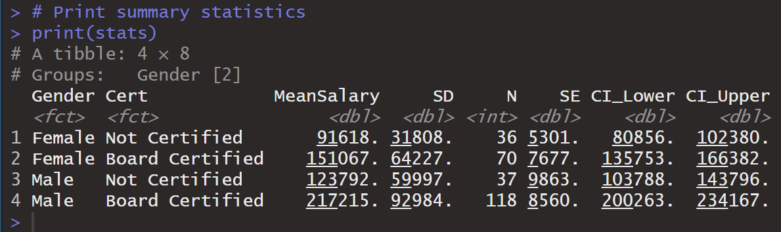
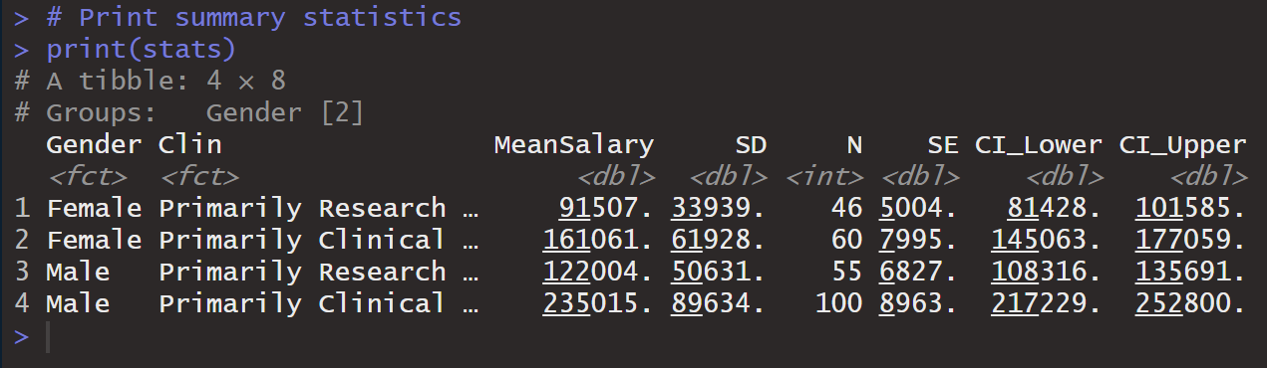
Gender vs Salary by Board Certification and Clinical Focus: Confidence Interval
Board Certification
Clinical Focus
Yee Hey
Non-overlapping of CIs between genders → suggests potential statistical difference in mean salary between genders at 95% confidence interval
Hence: 95% confident that there is gender discrimination in mean salary –
lower pay for females, even when considering board certification and clinical focus
Notes:
GENERAL: While board certification is associated with higher salaries for both genders, median salary for males higher than for females, regardless of board certification status.
Impact of Board Certification on salary: males experience a larger increase in salary when they become board certified compared to females. → Gaining certified is more rewarded for males than for females
GENERAL: While those in “Clinical” have higher salaries than those in “Research", median salary for males is higher than for females, regardless of clinical focus.
Impact of clinical focus on salary: males experience larger increase in salary when they switch from "Research" to "Clinical" compared to females. → "Clinical" focus is more rewarded for males than for females
Gender discrimination in salary → lower pay for females, even when considering board certification and clinical focus
—--------------------
GENERAL: median salary for males is higher than for females, regardless of board certification status.
Board Certification: For both genders, board certification is associated with higher salaries compared to not being certified.
Impact of Board Certification on salary: males experience a larger increase in salary when they become board certified compared to females. → Gaining certified is more rewarded for males than for females
GENERAL: median salary for males is higher than for females, regardless of clinical focus.
Clinical Focus: For both genders, individuals in the "Research" focus tend to have higher salaries compared to those in the "Clinical" focus.
Impact of clinical focus on salary: males experience a larger increase in salary when they switch from "Research" to "Clinical" compared to females. → "Clinical" focus is more rewarded for males than for females

Slide 17
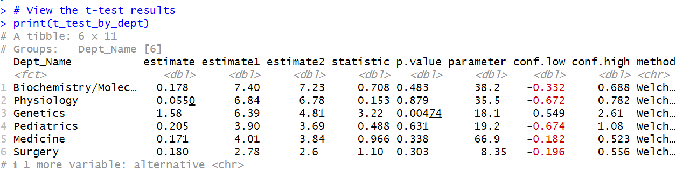
T-Test for Publication Rate by Department and Gender
estimate1: The mean publication rate for females.
estimate2: The mean publication rate for males.
p.value: The p-value, which indicates whether the difference in publication rates between males and females is statistically significant.
If p-value < 0.05, the difference is statistically significant.
If p-value ≥ 0.05, the difference is not statistically significant
The t-test results show that in Genetics, female doctors have a significantly higher publication rate than their male counterparts (p = 0.00474). This provides clear evidence that female doctors are more productive, yet are not compensated accordingly, indicating gender discrimination.
Muru

